Slide 2
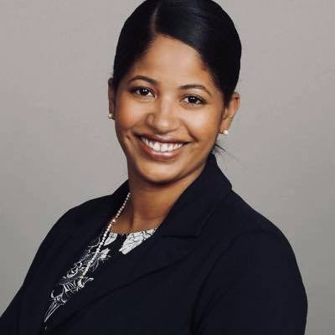
A little bit about Myriah
Chicago Native
Direct Service, Policy, Government
First Female CEO of New Life Center
Notes:
Community partners: county and city agencies, AZPOST, APAAC, ACFAN, ACESDV, etc.

Slide 3
Vision and Mission
History
What is DV
New Life Center
(NLC)
.
Our Programs
How to Help

Slide 4
NLC Vision and Mission
Vision:
Creating an Arizona where all live free from domestic and sexual violence
Mission:
Helping eliminate domestic and sexual violence through support services, education, and expertise

Slide 5
History of NLC
Founded in Litchfield, AZ in 1991
Largest Domestic Violence Shelter in the State
Majority of our residents are children
Achieved dual status in 2018
Trauma informed agency
Multidisciplinary Team Player

Slide 6
Domestic Violence
101

Slide 7
What is
domestic violence?
Domestic violence is a pattern of abusive behaviors in any intimate or family relationship that are used to gain and maintain power and control over another intimate/non intimate partner.

Slide 8
STATISTICS
National:
1 in 4
American women report physical and or sexual abuse by their male or female partner at some point in their lives.
1 in 7
American men report physical and or sexual abuse by their female or male partner at some point in their lives.
Arizona:
A child is witness to domestic violence every 40 minutes
CDC 2010

Slide 9
Relationship Test:
Married, dating or lived together
Child in common
Related by blood, marriage or court order
Child in the home related to either party
Teenage dating and/or sexual relationship
https://www.azleg.gov/ars/13/03601.htm
Notes:
Community partners: county and city agencies, AZPOST, APAAC, ACFAN, ACESDV, etc.

Slide 10
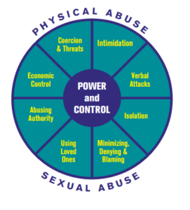
Power and
Control Wheel

Slide 11
What causes
domestic violence?
Theories:
Anger
Substance Abuse
Mental Health
Cultural Influences
Facts:
Learned Behavior
A Choice
Intentional-Power & Control
Notes:
Discuss prioritizing Basic

Slide 12
Barriers to Leaving :
Housing
Money
Fear & Shame
Children
Disability
Lack of support
LOVE
A promise that the person will change
Trauma
Notes:
Discuss prioritizing Basic

Slide 13
Myths:
It only happens to…
The victim provokes it
Only attracted to abusers
Alcohol and/or drug abuse
Uneducated
Key Points to Remember:
Each situation is more complex than staying or leaving
Remaining in the relationship does not mean acceptance or condoning of the abuse
Leaving does not necessarily mean the abuse will stop or that other risks will be reduced
Notes:
Probation: 3 different counties
Prosecutors: 3 different County attorney offices
Advocates: 3 different counties, 9 different agencies

Slide 14
NLC Programs:
Residential: 104 beds, 120 days
Children’s: Age appropriate programming
Outreach: Mobile Advocacy and Education
Lay Legal Advocacy: Navigating Arizona Family, Civil and Criminal Law
Housing: Low barrier funding
Sexual Assault Services: 24/7 Crisis Line, transitioning into 24/7 emergency response

Slide 15
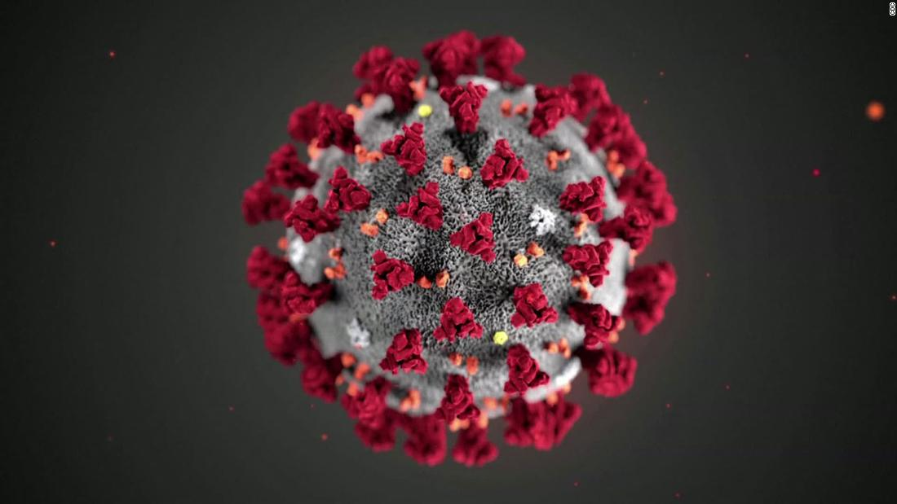
Pandemic Response to COVID19
Best practice guidelines from the CDC, Maricopa DOH, AZ Gov. EO
Only essential staff onsite
Professional cleaning service spraying weekly playground and campus high touch areas
No more than 10 people in communal areas

Slide 16
How to Help!
Donate: Gifts to New Life Center are eligible for tax credit!
Become a Volunteer
Donate Supplies
Shop at Hope’s
Newlifectr.org
Notes:
Discuss prioritizing Basic

Slide 17
Get Help Now,
Please Share!
24/7 (623) 932-4404
Facebook: @NewLifeCtr
Questions?
Big thanks to Priyanka Miller
and all NLC board members!

